Slide 1
Level 6 Group Project
Lenneth Dayaon Willoughby Axtell Dan Pokladek

Slide 2
Game Idea
Roguelite – same as a roguelike but some type of progress is preserved
Fast paced
2D top down
Mechanics – Shooting, collecting
Player character has abilities and dash
Skill based game - measurement, reflexes
Mental challenge – handling multiple resources simultaneously - health, timers, inventory cap
Made on Unity

Slide 3
Target Audience
Males
Age Range – 16 – 35
Hardcore players

Slide 4
Theme
There is a powerful mad wizard who has been bewitched by an evil witch who wants to bring the world to destruction and kill everything and everyone.
The witch uses the wizard’s power to ensure everything goes to plan.
Creatures are reanimated to fight and kill humans.
An Archer, much like Robin Hood, seeks to bring the good back to everyone, by taking on the challenge of defeating the witch and wizard and everything in between.

Slide 5
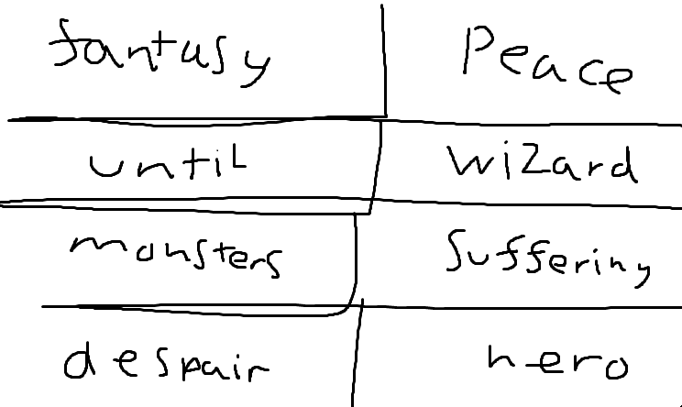
Narrative
Comic book style narrative

Slide 6
How the game plays
You are an archer who has 4 shooting abilities, some have cool downs. Also, you can dash.
You play the game by entering a room level and killing the enemies that are in that room level
Collect the gems that the enemies drop and then continue to the next room to kill more enemies and collect the gems.
Find the store to get some upgrades
Maybe go into a cave dungeon for rewarding upgrades
And when you are ready, find the boss portal and enter to fight the boss

Slide 7
How the game plays
Player Spawns in Level
Player navigates map and collects items during day
Player fights any enemies they come across
After a designated amount of time the game switches to night
During night more enemies spawn
Player will have to prioritize survival over exploration during this phase
During the night phase the player may fight the boss if this wish too
If they decide not to the day phase starts again
If they fight the boss and win, they will receive an item as a reward
The player will then proceed to the next level (Unless on the final level)
If the player character dies, they will restart the game

Slide 8
Progression
Each stage will be more challenging than the last resulting in a progression of difficulty between stages this would be done by adding more challenging enemy variants and more enemies, players would have to counteract these difficulty increases by either becoming more skilled at the game or collecting items that will make them more powerful and thus make the game easier. This could cause players to spend large amounts of time collecting items to make themselves more powerful, a second form of difficulty progression is employed to counteract this being that for every day that passes in game the day gets shorter resulting in less time to prepare during future stages.
The game will also naturally improve player skill through repetition, the enemies that the player encounters will feature very simple AI and thus will be predictable allowing the player to figure out how best to fight each individual enemy as the character class they have chosen. Repetition will allow the player to be more likely to beat the game the more times they play it, alternate characters will allow for further variety. Alternate characters could also add to the progression of the game by allowing the player to unlock new characters by achieving goals in the game.

Slide 9
What emotions/Fun do we want?
Tension – We want to create tension by making the game fast paced allowing players to be fully immersed and concentrated through sections of the game.
Hard Fun – providing players the opportunity of challenge, mastery and feelings of accomplishments. We will focus on the attention to a goal which is for the player defeat bosses and maybe in the future, to different parts of the map. The constraints and strategy of the way players will surpass through the maps with varied enemy’s with distinct properties. Mastering our mechanics as they play through random generated maps. To help them feel accomplishments to how far they get.
Frustration – perma death is a mechanic in our game so the player will have to start from the very beginning when they die.
Fiero – From the constant dying and failing, it will be more appreciated when players succeed to beat boss fights and proceed through the maps. This should evoke fierro through the player defeating an obstacle, especially one that is annoying. – needs more work
Relief – Players can have relief after defeating boss fights and have times in the game where they are able to just have some time to pause or slow down without affecting their player’s life. This is also felt when enemies are defeated in the room level. Players get a bit of a break.

Slide 10
Core Game Loop
Kill – Action
Collect – Reward and anticipation
Get Stronger by buying items – Anticipation and reward
We need to create more anticipation (show the players what they could be)

Slide 11
The compulsion loop
Endowed progress – to make the players keep playing, what do they keep when they die?
The Availability Heuristic - what makes the game memorable?
Our solution
- Roguelite what does player keep?
High score – big numbers for enemy kills
Boss room – give the players a lot of gems
Kill count = out of 25 (how many required enemy kills)

Slide 12
Features in our game
Day and night cycle
Shopkeeper
Various short and long range enemies
Different player abilities
Probabilities on item & enemies

Slide 13

Giving player feedback (telegraphing)

Slide 14
Giving the game more juice – Rewarding feedback

Slide 15
From research – making the game more impactful

Slide 16
UI screens
Pause Screen
- Volume toggle - Restart
Menu Screen
- Play button - Iconomincon
Death Screen
Telegraph the enemy dying
Options screen - volume and music toggle
Loading screen

Slide 18
Day and night Cycle
-progressive – day night midnight dawn day
Visual quicker progression would start few seconds before next stage
Days and nights will be longer around the same
What is the day and night cycle for?
Day – enemies
Night – Double enemies
Narrative
-

Slide 19
Adam’s playtesting
Volume toggle
We have screen shake
And sound effect but no sound effect for q and e
Test dummies
Redoing slimes as damage doesn’t work
Visual feedback on player when low health
The E ability needs to have better telegraphed area of effect
Make sure order layer is right
Telegraph how many enemies you have killed

Slide 20
Space icon when coming up to shop instead
Nice portal
He explored the map
Make the souls more distinct that they are not like bullets
Let player know in the tutorial – night
Interactive text for the shopkeeper

Slide 21
Killed enemies? Whats the value of that?
Ghost particles need to be telegraphed better
The boss portal
Why is the player here? No story
What is the day and night cycle about
Pause menu

